Slide 1
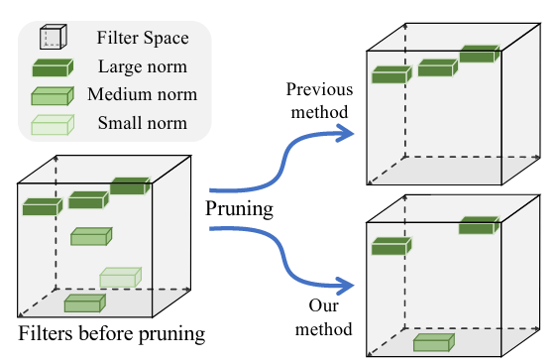

Filter Pruning via Geometric Median
Yang He et al. (CVPR 19)
J. Miguel Valverde
@jmlipman
15/08/2021

Slide 2
Outline
What is Pruning?
Existing methods
Filter Pruning via Geometric Median

Slide 3

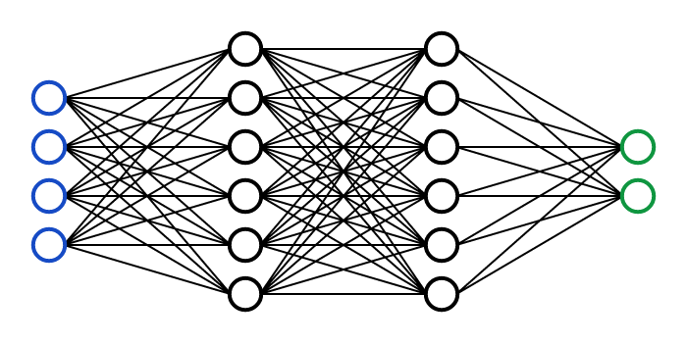
Pruning
But why?

Slide 4
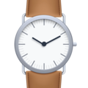




Pruning
But why?
Low computational capabilities.
Storage
Memory
Processor
Battery
More transparent

Slide 5
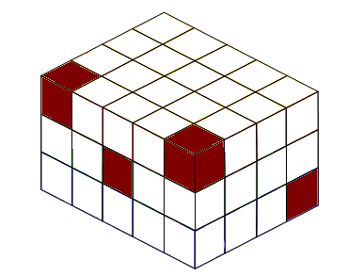
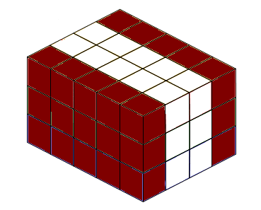
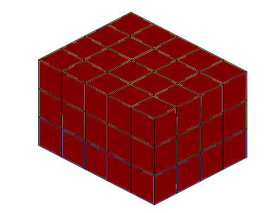
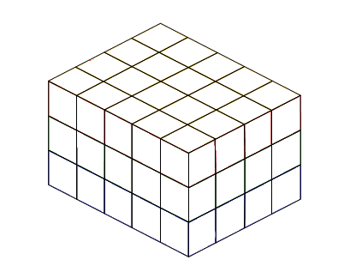
Types of Pruning
Unstructured pruning
Structured pruning
Reminder: In CNNs, weights have the shape of (I x O x K x K)

Slide 6

Types of Pruning
Structured pruning
No need of specialized libraries or hardware
32 x 64 x 3 x 3
20 x 16 x 3 x 3
Reminder: In CNNs, weights have the shape of (I x O x K x K)

Slide 7
Filter Pruning
Pruning strategy (when)
Pruning method (how)

Slide 8
Filter Pruning
3 steps
Loop
Pruning strategy (when)
Pruning method (how)
Train
Prune
Fine-tune

Slide 9
Filter Pruning
2 steps
2 steps
Loop
Pruning strategy (when)
Pruning method (how)
Train
Prune
Fine-tune
Train
Prune
Fine-tune

Slide 10
Filter Pruning
3 steps
Multiple repetitions
Loop
Pruning strategy (when)
Pruning method (how)
Train
Prune
Fine-tune

Slide 11
Filter Pruning
Goal: “Remove unimportant channels”
Rank
Pruning strategy (when)
Pruning method (how)
0.38
0.11
0.94
0.62
0.18
0.08
0.44
0.15
0.84
0.97

Slide 12
Filter Pruning
Goal: “Remove unimportant channels”
Rank
Threshold
Pruning strategy (when)
Pruning method (how)
0.38
0.11
0.94
0.62
0.18
0.08
0.44
0.15
0.84
0.97
0.38
0.11
0.94
0.62
0.18
0.08
0.44
0.15
0.84
0.97

Slide 13
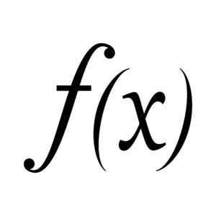
Filter Pruning
Goal: “Remove unimportant channels”
Rank
Heuristic function (L1, L2, Rank, Derivative, …)
Filter descriptor (Weights, feature maps)
Pruning strategy (when)
Pruning method (how)

Slide 14
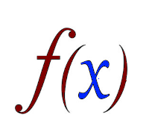
Filter Pruning
Goal: “Remove unimportant channels”
Some examples of
L1 norm of the weights (Deep Model Compression based on the Training History, 2021)
L2 norm of the gradients (Localization-aware channel pruning for object detection, 2020)
Rank of feature maps (HRank: Filter Pruning using High-Rank Feature Map, 2020)
L1 norm of Pearson’s correlation of feature maps (Filter Distillation for Network Compression, 2020)
Loss difference (weights) between pruned and non-pruned (Gate Decorator, 2019)
Pruning strategy (when)
Pruning method (how)

Slide 15
Filter Pruning
Goal: “Remove unimportant channels”
Rank
(Via architectural changes)
Pruning strategy (when)
Pruning method (how)
0.38
0.11
0.94
0.62
0.18
0.08
0.44
0.15
0.84
0.97

Slide 16
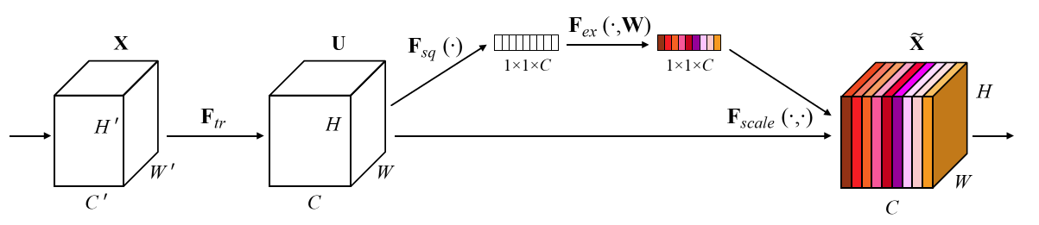
Filter Pruning
Goal: “Remove unimportant channels”
Rank
Squeeze and Excitation!
Pruning strategy (when)
Pruning method (how)
0.38
0.11
0.94
0.62
0.18
0.08
0.44
0.15
0.84
0.97

Slide 17
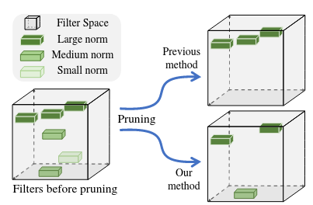
Filter Pruning via Geometric Median
Goal: “Remove redundant channels”
High L1/L2 norm → important
But they might be redundant...
Pruning strategy (when)
Pruning method (how)

Slide 18



Filter Pruning via Geometric Median
There are two problems in smaller-norm-less-important approaches
Example of norms
[8, 7, 5]
8

Slide 19
Filter Pruning via Geometric Median
There are two problems in smaller-norm-less-important approaches
Problem 1)
“The deviation of filter norm distributions might be too small, which means the norm values are concentrated to a small interval”

Slide 20
Filter Pruning via Geometric Median
There are two problems in smaller-norm-less-important approaches
Problem 1)
“The deviation of filter norm distributions might be too small, which means the norm values are concentrated to a small interval”
0.13
0.11
0.14
0.12
0.18
0.08
0.14
0.15
0.14
0.17

Slide 21
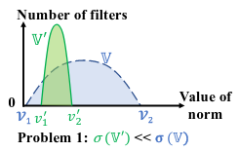
Filter Pruning via Geometric Median
There are two problems in smaller-norm-less-important approaches
Problem 1)
“The deviation of filter norm distributions might be too small, which means the norm values are concentrated to a small interval”
0.13
0.11
0.14
0.12
0.18
0.08
0.14
0.15
0.14
0.17
“A small norm deviation leads to a small search space, which makes it difficult to find an appropriate threshold to select filters to prune”

Slide 22
Filter Pruning via Geometric Median
There are two problems in smaller-norm-less-important approaches
Problem 2)
“The filters with the minimum norm may not be arbitrarily small”
32.38
31.11
34.94
31.62
32.18
33.08
33.44
31.15
34.84
30.97

Slide 23
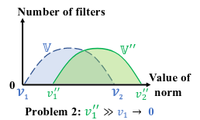
Filter Pruning via Geometric Median
There are two problems in smaller-norm-less-important approaches
Problem 2)
“The filters with the minimum norm may not be arbitrarily small”
32.38
31.11
34.94
31.62
32.18
33.08
33.44
31.15
34.84
30.97
“Those filters considered as the least important still contribute significantly to the network, which means every filter is highly informative”

Slide 24
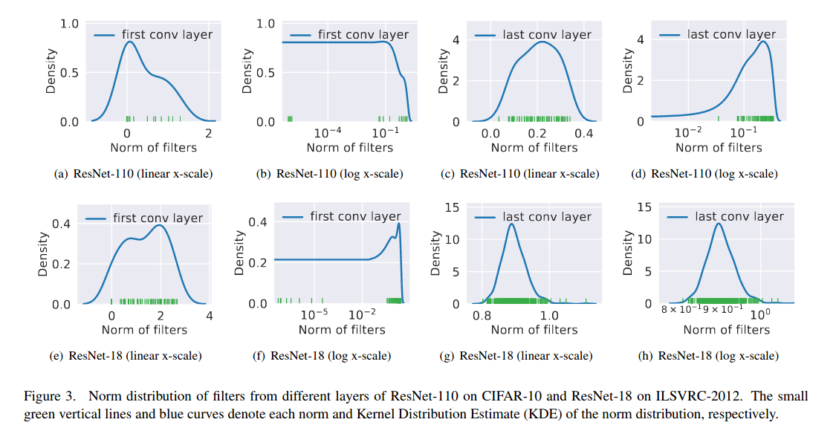
Filter Pruning via Geometric Median
Analysis on CIFAR-10 and ImageNet

Slide 25
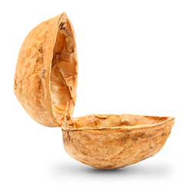
Filter Pruning via Geometric Median
The idea, in a nutshell:
Find the most replaceable filters with the median, and remove them!

Slide 26
Filter Pruning via Geometric Median
The idea, in a nutshell:
Remove the median
Find the most replaceable filters with the median, and remove them!

Slide 27
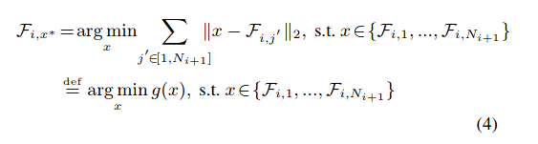
Filter Pruning via Geometric Median
“Find which filter minimizes the summation of the distance with other filters”

Slide 28
Filter Pruning via Geometric Median
“Find which filter minimizes the summation of the distance with other filters”

Slide 29
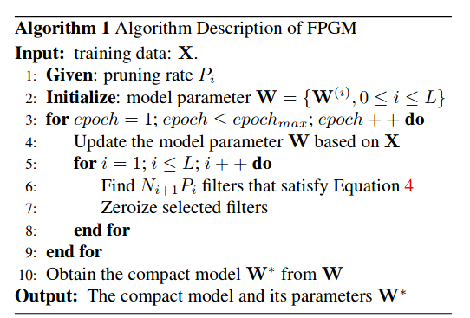
Filter Pruning via Geometric Median
“The geometric median is a classic robust estimator of centrality for data in Euclidean spaces”
“Median filter”
Finally, you could fine-tune

Slide 30
Filter Pruning via Geometric Median
Experiments and conclusions
1) Compare to other methods in ResNet, VGG, CIFAR, ImageNet
Better results (accuracy, FLOPs ↓)

Slide 31
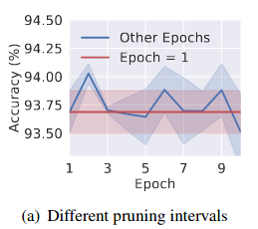
Filter Pruning via Geometric Median
Experiments and conclusions
1) Compare to other methods in ResNet, VGG, CIFAR, ImageNet
Better results (accuracy, FLOPs ↓)
2) Ablation
- The pruning interval doesn't really change too much
- L1 distance > Cosine distance (distance for computing the median)
- Mixing small-norm-less-important methods and their method vs utilizing their method yields similar results.

Slide 32
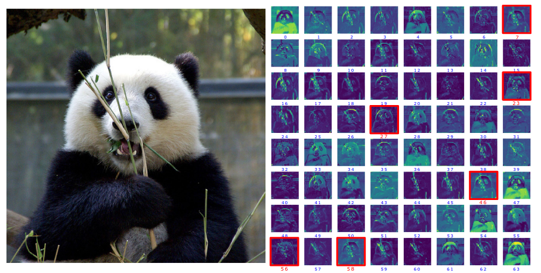
Filter Pruning via Geometric Median
Experiments and conclusions
3) Feature maps viz. when pruning 10% of the filters
Red = pruned

Slide 33
Filter Pruning
Questions?

